Slide 1
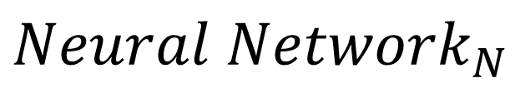
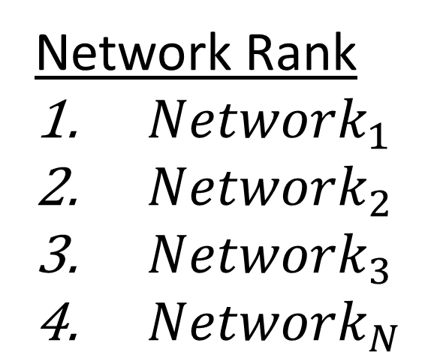
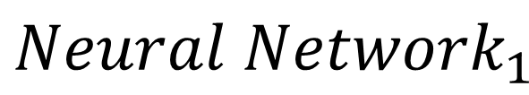
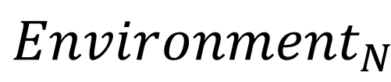
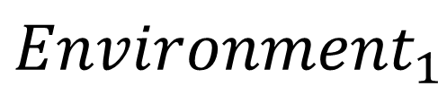
Hyper Parameter optimizations with Genetic Algorithms and Reinforcement learning
Presenter: Danny Ly Advisor: Dong Si
Genetic Algorithms Used to solve optimization problems through natural selection | Aims and Objectives | Outcomes/ What I learned Similar performance as non-genetic network Faster trained network Adequate machine learned Ping-Pong game performance
Knowledge involved CSS343/2: Structures & Algorithms CSS360: Software Design CSS485: Artificial Neural Networks CS470: Operating Systems | Design Work Flow
Tools Used
Design and implement an network optimizer using genetic algorithms
Population
Thread Manager
Training and learning
$${Environment}_{1}$$
$${Neural Network}_{1}$$
Optimizer
Each Generation inherits traits from fit parent Neural Networks
$${Environment}_{N}$$
Next Generation
$${Neural Network}_{N}$$
Network Rank
${Network}_{1}$
${Network}_{2}$
${Network}_{3}$
${Network}_{N}$
Breed & Mutate
Kill Unfit Networks

Slide 2
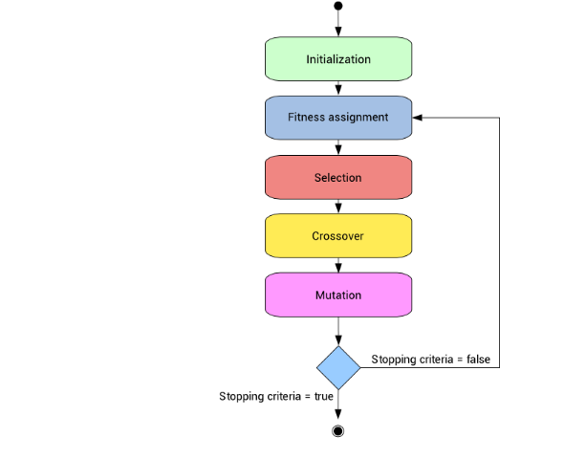
Breed & Mutate
population
Breed
Thread Manager
Kill unfit Networks
Leaderboard
1: Parent 1
2: Parent II

